Slide 1
Chapter 2: Intelligent Agent
Notes:
(c) 1999. Tralvex Yeap. All Rights Reserved

Slide 2
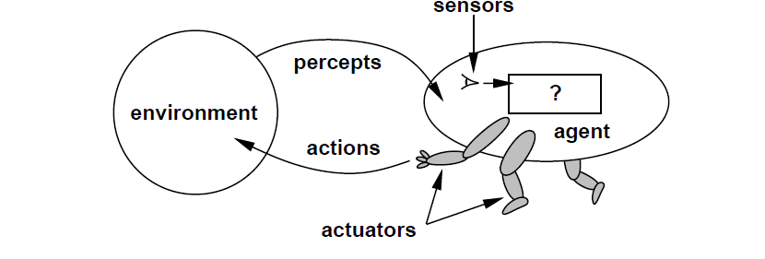
Agents
An agent is anything that can be viewed as
  perceiving its environment through sensors and
  acting upon that environment through actuators

Slide 3
Agents
  Agents include humans, robots, softbots,…etc
  Human agent:
    Sensors: eyes, ears, ...
    Actuators: hands, legs, mouth, …
  Robotic agent:
    Sensors: cameras and infrared range finders
    Actuators: various motors
Software agent:
  Sensors: keystrokes, file contents, and network packets
  Actuators: screen, writing files, and sending network packets

Slide 4

Agent function and agent program
The agent function maps from percept histories to actions:
An agent program implements the agent function to run on a physical architecture.

Slide 5
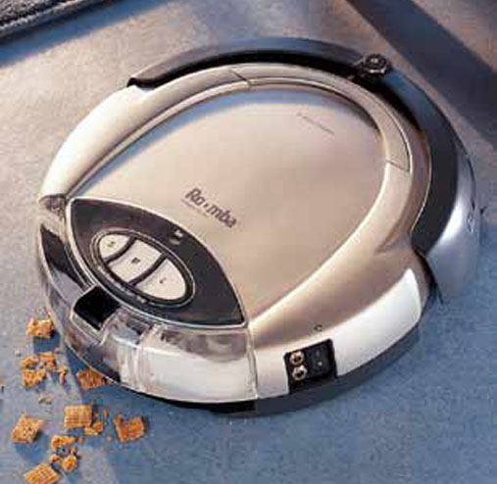
Example: A Vacuum-cleaner agent
A
B
Percepts:location and contents, e.g. [A, dirty]
  (Idealization: locations are discrete)
Actions: LEFT, RIGHT, SUCK, NOP

Slide 6
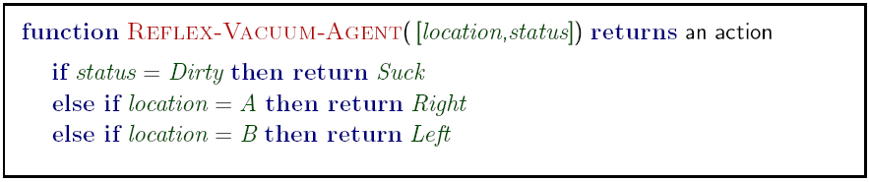
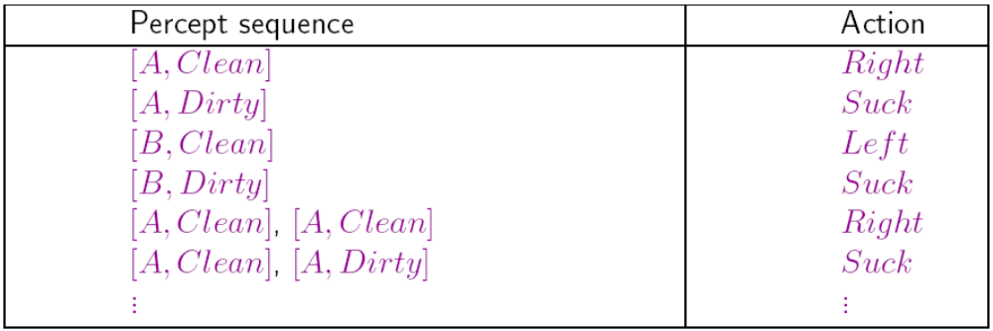
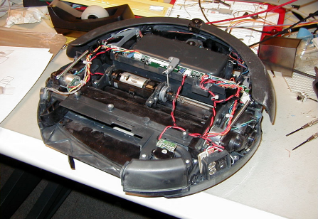
A Reflex Vacuum-Cleaner

Slide 7
Rationality
Rationality depends on:
  Performance measure
  Agent’s (prior) knowledge
  Agent’s percepts to date
  Available actions
Rational Agent Definition
For each possible percept sequence, a rational agent should select an action that is expected to maximize its performance measure, given the evidence provided by the percept sequence and whatever built-in knowledge the agent has.
Notes:
(c) 1999. Tralvex Yeap. All Rights Reserved

Slide 8
Rational Agent
Rational agent maximizes the expected utility.
We take the expectation of the utility due to uncertainty in environment (stochastic and partially-observable).

Slide 9
Rational Agent
Consider the simple vaccum cleaner that cleans a square if it is dirty and moves to the other square if not. Is it rational?
  It depends!
Assume that there is a penalty of one point for each movement left or right, is the this simple cleaner rational?
  No, it would performs poorly as it oscillates between right and left locations after cleaning them.
What if clean squares can become dirty again?
  The agent should occasionally check and re-clean them if needed.

Slide 10
Rationality versus Omniscience
A rational agent chooses whichever action maximizes the expected value of the performance measure given the percept sequence to date.
Rational ≠ omniscient
An omniscient agent knows the actual outcomes of actions and acts accordingly.
Rationality does not mean perfection!
Rationality maximizes the expected performance, while perfection maximizes the actual performance.

Slide 11
Learning and autonomy
An agent can learn from what it perceives.
A rational agent should be autonomous—it should learn what it can to compensate for partial or incorrect prior knowledge.
For example, a vacuum-cleaning agent that learns to forecast where and when additional dirt will appear will do better than one that does not.

Slide 12

Task environment
To design a rational agent we need to specify a task environment
  a problem specification for which the agent is a solution
PEAS: to specify a task environment
  Performance measure
  Environment
  Actuators
  Sensors

Slide 13
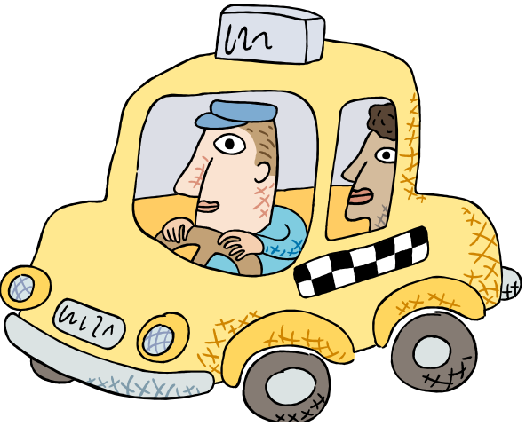
PEAS: Specifying an automated taxi driver
Performance measure:
  ?
Environment:
  ?
Actuators:
  ?
Sensors:
  ?

Slide 14
PEAS: Specifying an automated taxi driver
Performance measure:
  safety, speed, legal, comfortable, maximize profits
Environment:
  ?
Actuators:
  ?
Sensors:
  ?

Slide 15
PEAS: Specifying an automated taxi driver
Performance measure:
  safe, fast, legal, comfortable, maximize profits
Environment:
  roads, other traffic, pedestrians, customers
Actuators:
  ?
Sensors:
  ?

Slide 16
PEAS: Specifying an automated taxi driver
Performance measure:
  safe, fast, legal, comfortable, maximize profits
Environment:
  roads, other traffic, pedestrians, customers
Actuators:
  steering, accelerator, brake, signal, horn
Sensors:
  ?

Slide 17
PEAS: Specifying an automated taxi driver
Performance measure:
  safe, fast, legal, comfortable, maximize profits
Environment:
  roads, other traffic, pedestrians, customers
Actuators:
  steering, accelerator, brake, signal, horn
Sensors:
  cameras, sonar, speedometer, GPS

Slide 18
PEAS: Internet Shopping Agent
  Performance measure: price, quality, appropriateness, efficiency
  Environment: current and future WWW sites, vendors, shippers
  Actuators: display to user, follow URL, fill in form
  Sensors: HTML pages (text, graphics, scripts)

Slide 19
PEAS: Spam Filtering Agent
  Performance measure: false positives, false negatives
  Environment: email client or server
  Actuators: mark as spam, delete,…
  Sensors: emails , traffic, etc.

Slide 20
Task Environment Types
Fully observable (vs. partially observable): An agent's sensors give it access to the complete state of the environment at each point in time.
Deterministic (vs. stochastic): The next state of the environment is completely determined by the current state and the action executed by the agent.
In a fully-observable and deterministic environment the agent need not deal with uncertainty.
Episodic (vs. sequential): An episodic environment means that subsequent episodes do not depend on what actions occurred in previous episodes. Such environments do not require the agent to plan ahead.
Notes:
If an agent's sensors give it access to the complete state of the environment needed to choose an action, the environment is accessible to the agent. Such environments are convenient, since the agent is freed from the task of keeping track of the changes in the environment.
Partially observable is due to noisy, inaccurate sensor measure or because parts of the state are not covered by the sensors.
An environment is deterministic for an agent if the next state of the environment is completely determined by the current state of the environment and the action of the agent. In an accessible and deterministic environment the agent need not deal with uncertainty.

Slide 21
Task Environment Types
Static (vs. dynamic): An environment which does not change while the agent is thinking is static.
In a static environment the agent need not worry about the passage of time while he is thinking, nor does he have to observe the world while he is thinking.
In static environments the time it takes to compute a good strategy does not matter.
If the environment itself does not change with the passage of time but the agent’s performance score does, then we say the environment is semi-dynamic.
Notes:
If the environment itself does not change with the
passage of time but the agent’s performance score does, then we say the environment is
SEMIDYNAMIC semidynamic.

Slide 22
Environment Types
Discrete (vs. continuous): : If the number of distinct percepts and actions is limited the environment is discrete, otherwise it is continuous.
Single agent (vs. multi-agent): An agent operating by itself in an environment.
If more than one agent exists consider cooperation, coordination, competition, communication or random behavior.
What’s the real world like?

Slide 23
Environment Types
The environment type largely determines the agent design
The real world is partially observable, stochastic, sequential, dynamic, continuous, multi-agent
 | Crossword puzzle | Back-gammon | Part-picking Robot | Taxi
Fully-Observable
Deterministic
Episodic
Static
Discrete
Single-Agent

Slide 24
Agent Structure
Agent= Architecture+ Program
The job of AI is to design the agent program that implements the agent function mapping percepts to actions.

Slide 25
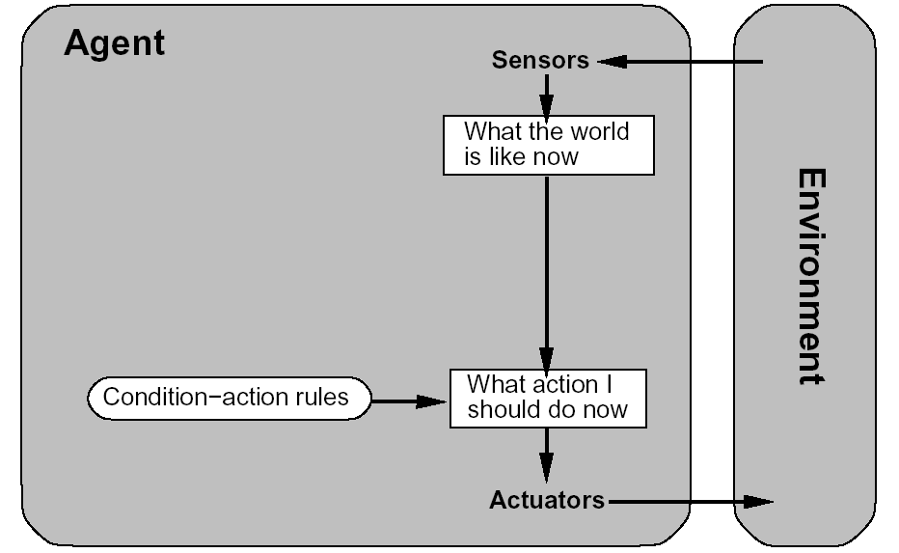
Simple reflex agent
function REFLEX_VACUUM_AGENT( percept )
returns an action
(location,status) = UPDATE_STATE( percept )
if status = DIRTY then return SUCK;
else if location = A then return RIGHT;
else if location = B then return LEFT;

Slide 26
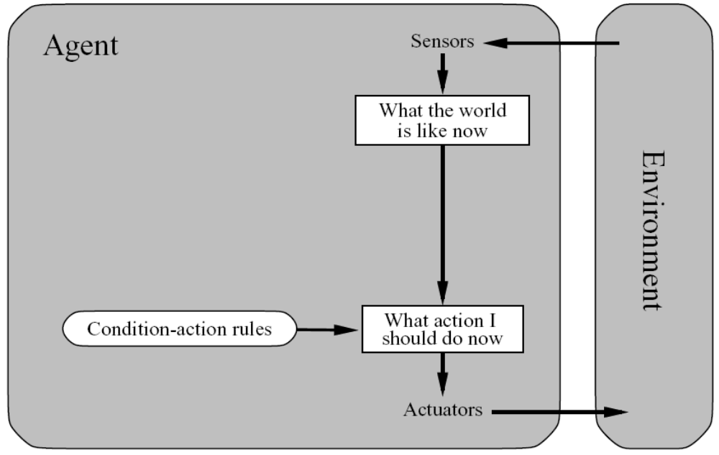
Simple Reflex Agents
What is the problem of this design?
Notes:
These agents select actions on the basis of the current percept, ignoring the rest of the percept history.
Does not handle partial observable environments.
Example:
Vaccum cleaner with only one status sensor, and no location sensor.

Slide 27
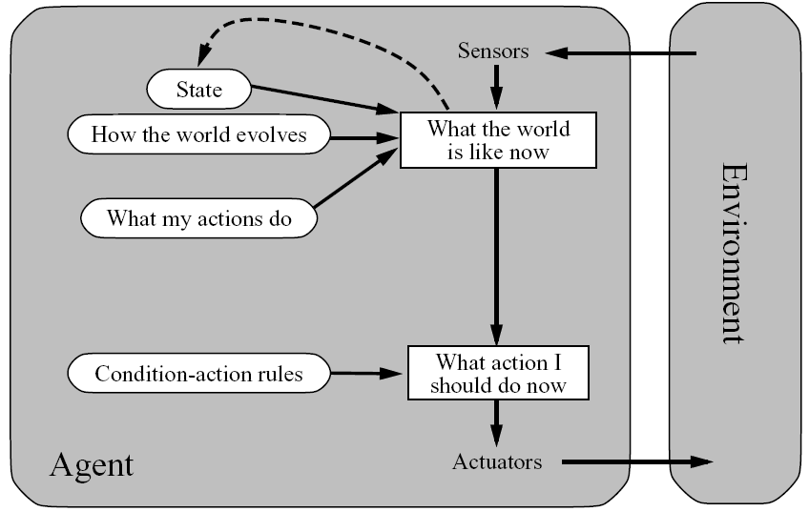
Reflex Agents with State (Model)
Can handle partially observable environments.
By keeping an internal state of the world ( a model of the world) defining how the world evolves. Not exactly (uncertainty/inference).

Slide 28
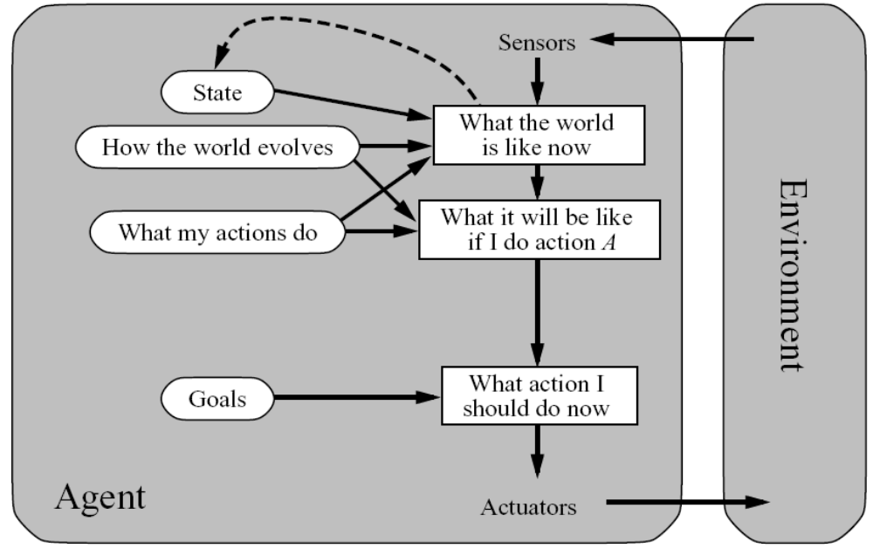
Goal-Based Agents

Slide 29
Goal-Based Agents
Embed the goal info describing the agent desirable behavior.
These agents usually first find plans then execute them.
Examples: Search (Ch3-5) and planning (Ch10)
More adaptive to different environments than reflex agents.
Notes:
Rain
Changing destination
(c) 1999. Tralvex Yeap. All Rights Reserved

Slide 30
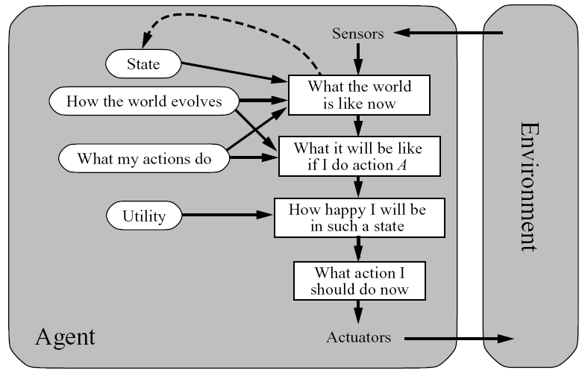
Utility-Based Agents
How is this different from a goal-based agent?
Notes:
Utility defines performance measure.
Can combine multiple goals into a single utility function and can weight them according to their importance.
Auto driver example, which way is safer/quicker
Rational agent maximizes the expected utility.
Expected due to uncertainty in environment (stochastic and partially-observable).

Slide 31
Utility-Based Agents (cont.)
Goals alone are not enough to generate high-quality behavior in most environments
The utility defines performance measure.
Can combine multiple goals into a single utility function and can weight them according to their importance.
For example: The auto driver agent, which way is safer/quicker.
Simple and complex decisions (Ch16,17)

Slide 32
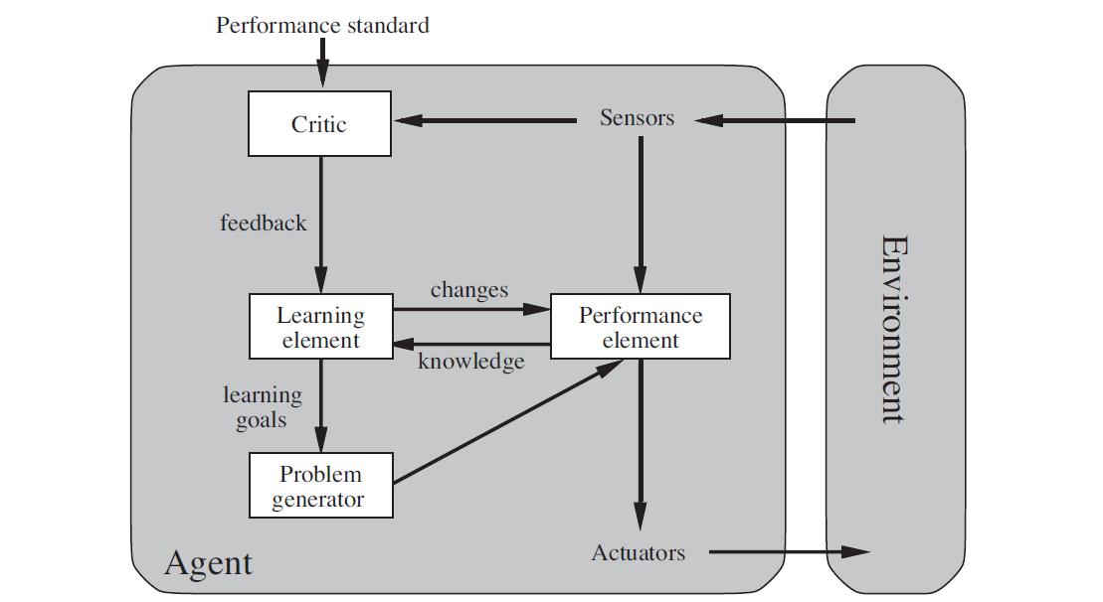
Learning Agent

Slide 33
Learning Agent
The learning agent allows the agent to operate in initially unknown environments and it can adapt to different environments as well.
The components of the learning agent:
  Learning element: it improves the agent’s performance
  Performance element: it takes in percepts and decides on actions. (Agent itself in the previous structures)
  Critic: It gives feedback to the learning element on how the agent is doing and determines how the performance element should be modified to do better in the future
  Problem generator. It suggests actions that will lead to new and informative experiences. (exploration)
Notes:
(c) 1999. Tralvex Yeap. All Rights Reserved

Slide 34
Summary
Agents interact with environments through actuators and sensors
  The agent function describes what the agent does in all circumstances
  The agent program implements the agent function
A rational agent maximizes expected performance
PEAS descriptions define task environments
Environments are categorized along several dimensions:
  Observable? Deterministic? Episodic? Static? Discrete? Single-agent?
Agent program types:
  Simple reflex, model-based agents, reflex agents, goal-based agents, utility based agents, and learning agents

